Slide 1
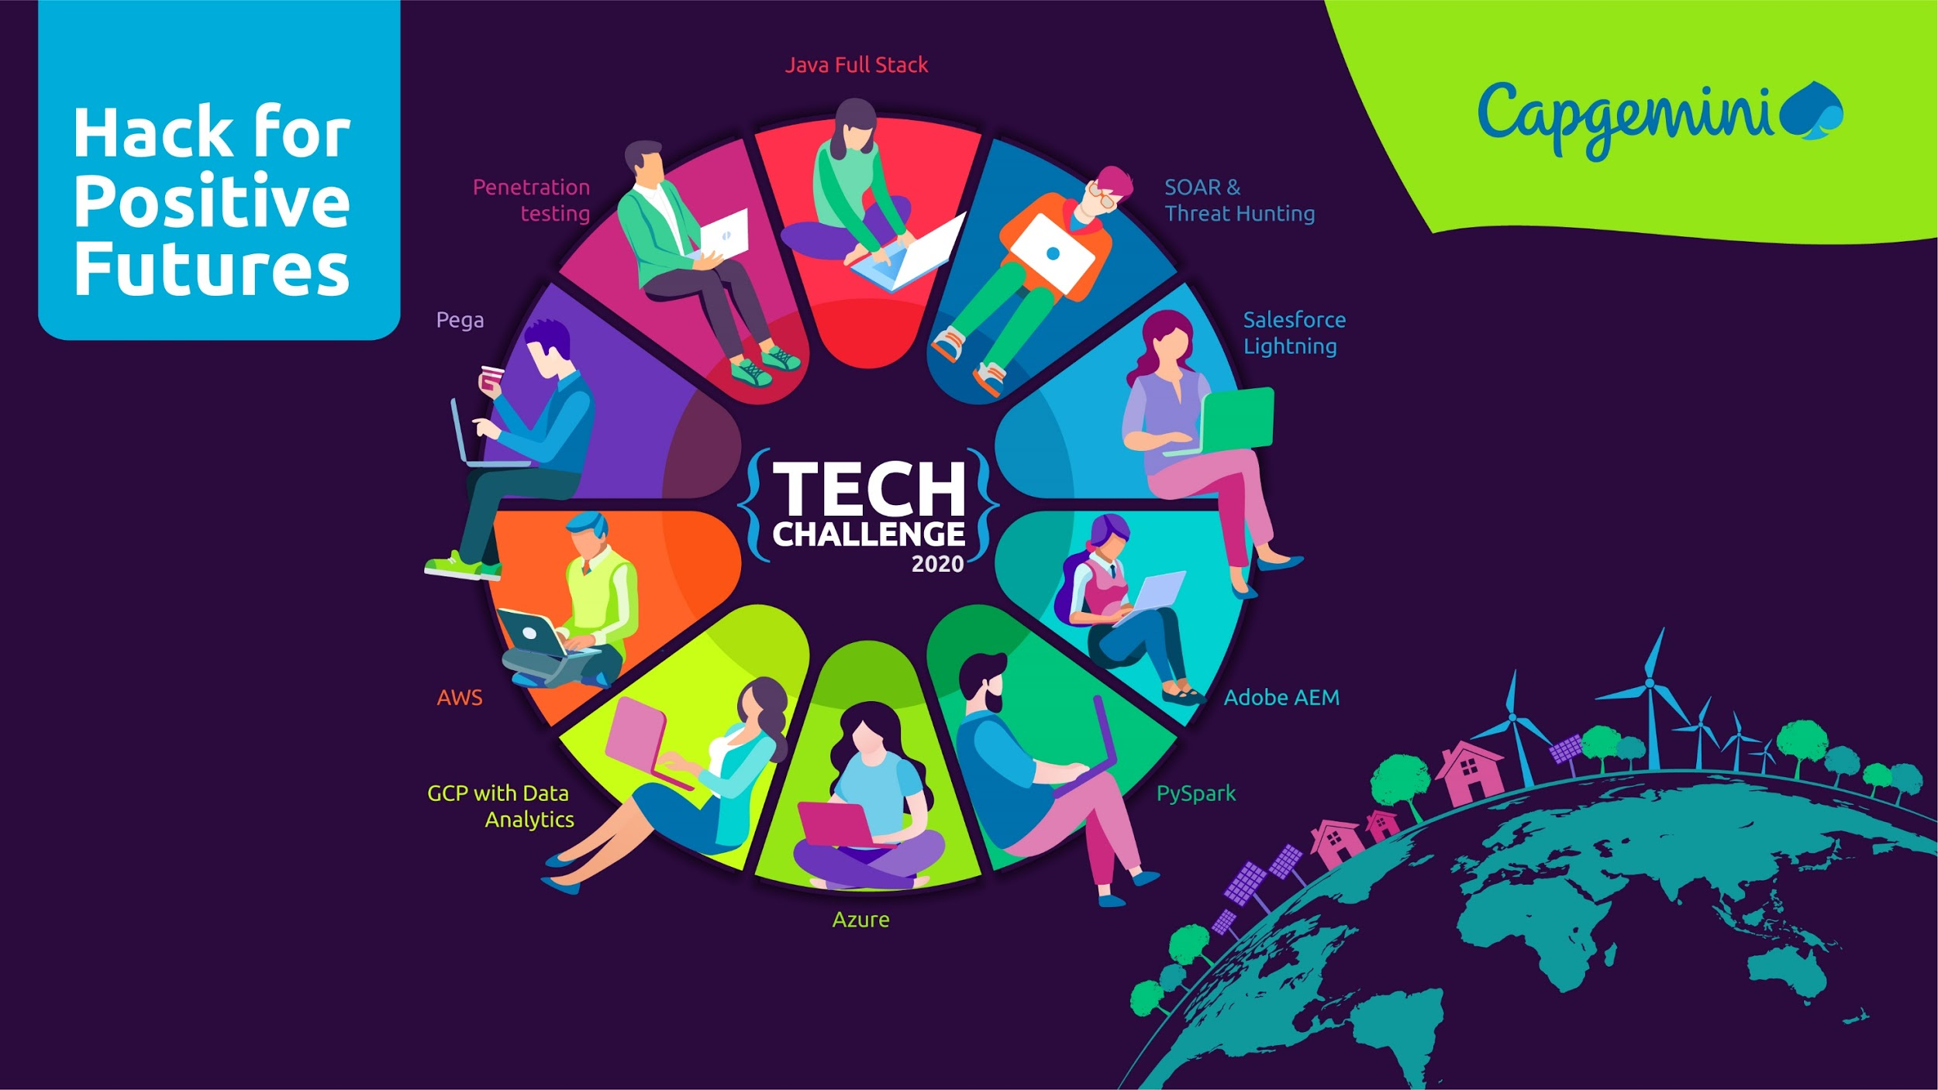
The Finale Challenge
CORONA404

Slide 2
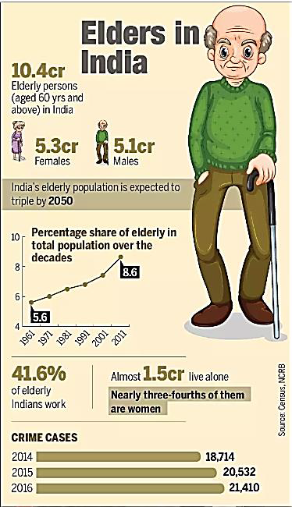
Synopsis
Gerontechnology for Assisted Living and Health Monitoring
Device a solution using emerging technologies, to address
Mobility for people with special needs including people with disabilities & geriatrics
Accessibility for people with special needs that include people with disability & geriatrics to basic health services in their local areas and online as well

Slide 3
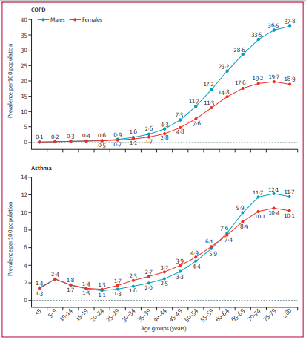
Problem Being Solved
Number of Older adults of age 60+ are increasingly facing chronic respiratory illness due to several factors.
India has a disproportionately high burden of chronic respiratory diseases
Chronic respiratory diseases include chronic obstructive pulmonary disease (COPD), asthma, pneumoconiosis, interstitial lung diseases, and Novel Coronavirus etc.
Many of these disease are undetected at the early onset due to reasons like:
patient does not show any symptoms.
Inaccessibility to basic health monitoring facilities
So, What’s the solution to overcome this problem ?

Slide 4
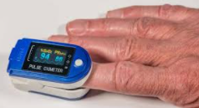
Solution overview
The blood oxygen saturation level (SpO2, amount of hemoglobin carrying oxygen) of a normal person is around 95 percent or more. However, in conditions that affect the lungs like pneumonia, the blood saturation levels drop below 94%. This condition is called hypoxemia.
Pulse oximeters provides a noninvasive estimation of the arterial hemoglobin oxygen saturation (SpO2 ). SpO2 has been widely used in intensive care units, operating rooms, and primary care in the detection of hypoxemia
Solution: OXI-LYF
Remote monitoring of vital metrics like SpO2 and pulse rate and
alerting the user about the forecasted risks based on patterns
with the help of Machine Learning Algorithms, advance alerting and IOT techniques.

Slide 5
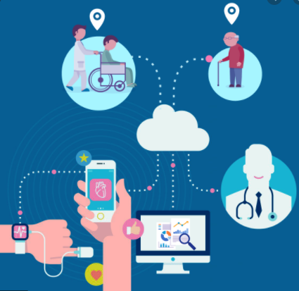
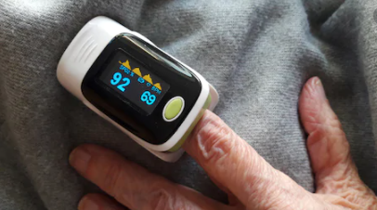

Solution Architecture
b. Device eligibility assessment
c. Device shipment to the eligible user
d. User captures readings, 3 times/day
a. Get users registrations
Users- adults of age 60+ years
Eligible- Users who are diagnosed with respiratory diseases(variable)
Device- Pulse oximeter with Bluetooth enabled(variable)
Process done at home by users or caretakers
Transmission from android app to our database along with GPS location details
Process the streaming data and obtain insights
Machine learning models predicts/forecast the risks post analysis
Clinical decision support for assessing which patient is at risk
Generate alert for User by informing the forecasted health risk
Generate alert to nearby healthcare centre
e. Data transmitted to our database
f. Analyse data
h. Clinical decision support
g. Forecast health risk
j. Alert nearby hospital
i. Alert user if risk detected

Slide 6
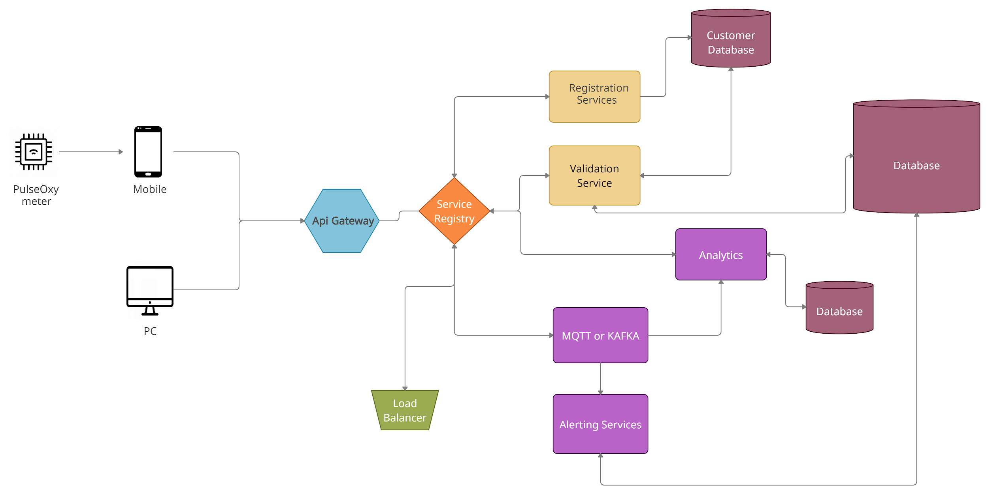
Technical Architecture

Slide 7






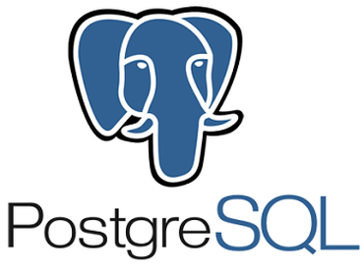


Technology Stack
Pega Personal edition
Jupyter Notebook
Google cloud Platform
Bigquery
Python
Postgres
Kafka
Spring
MongoDB

Slide 8
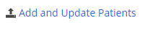
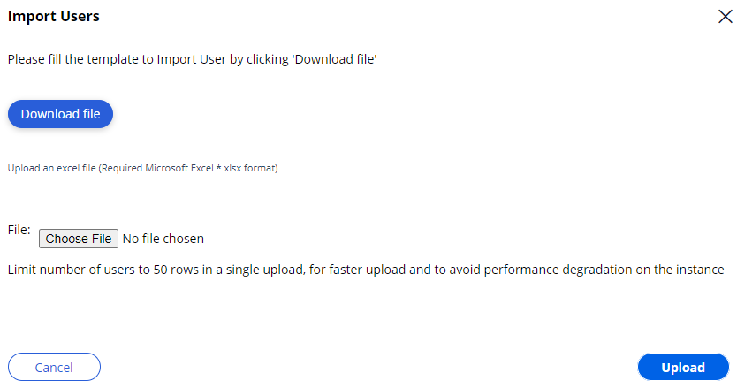
User Registrations(Initial Registration)
User Registrations will be done in 2 ways
Initial Registration : This method is used to onboard candidates initially for evaluation purpose, the dataset is derived from gathering information via old age homes and uploading the data into BPM Pega system via Bulk upload feature.

Slide 9
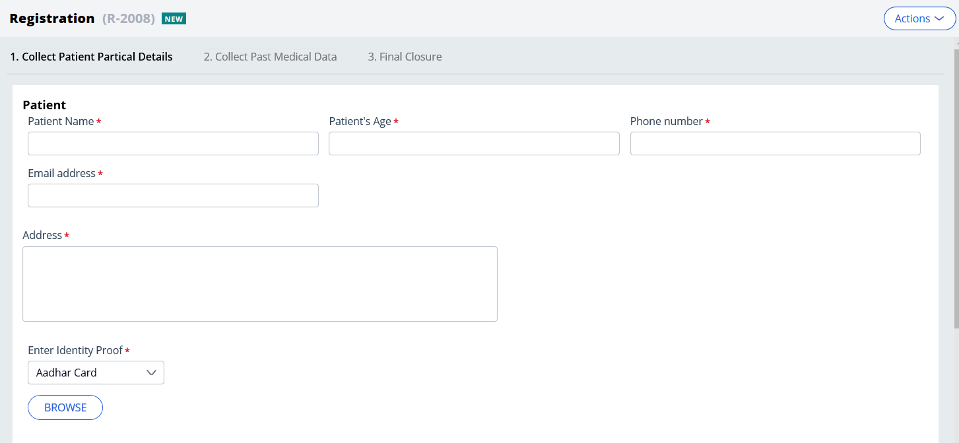
User Registrations(Opted Registrations)
Opted Registration : This method will be used by patients if they willingly want to enroll. The link will be hosted on an open website via Pega Mashup Functionality.

Slide 10
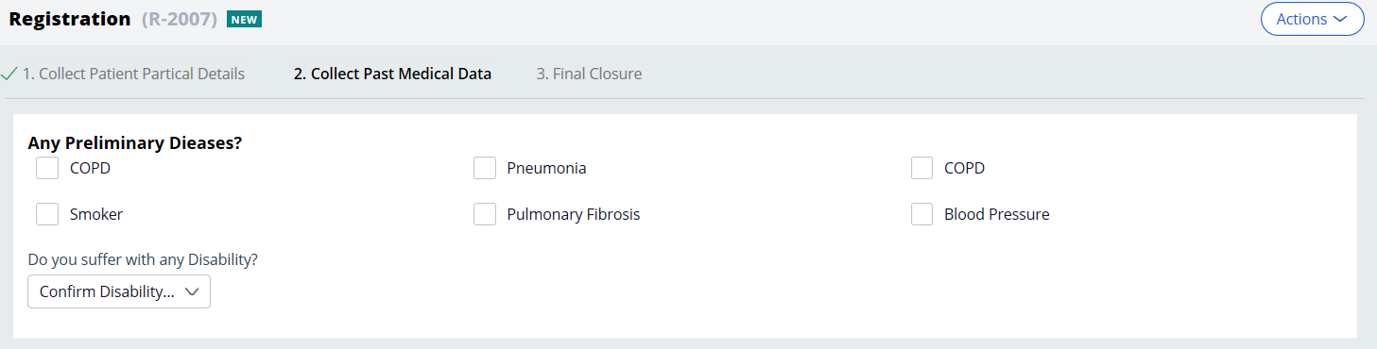
Device Eligibility Assessment
The Device Eligibility Assessment will be based on the inputs provided regarding the past medical history for an patient.
The data will be any preliminary respiratory disease in past as below.

Slide 11
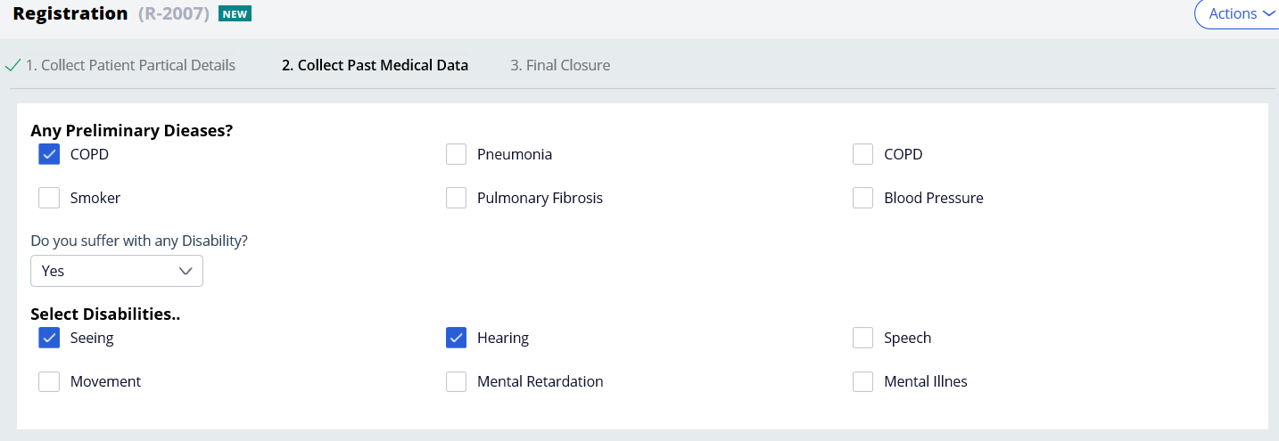
Device Eligibility Assessment
Any disability condition can be also captured by selection “Yes” for Disability option.

Slide 12
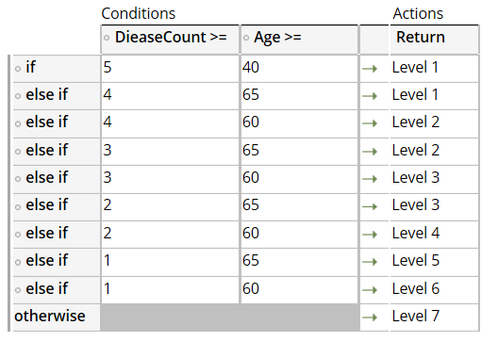
Device Shipment Logic
There will be third party delivery partners that will be responsible for the shipment of the oximeter device. But before the shipment , decision has to be taken based on the past medical history collected for the patient.
The decisioning will be done automatically via the Business Rules and later approved by the Admins at the end of each day.
The business logic will be derived from the below table
Depending of the Level of risk the patient is prone to he/she will be shortlisted based on the availability of the devices for that day
If the patient is selected an Email Notification will be triggered.
Background job will be running at the end of each day to consolidate the candidates and pass the shipping details to the shipment partner.

Slide 13
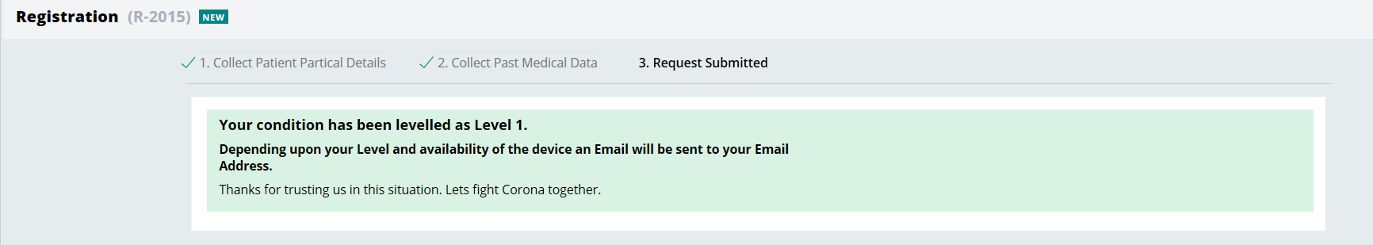
Notification
The below screen will be shown notifying the risk level and then depending on the availability of the device for that day, background job will access and send the notification whether the device will be sent or not.

Slide 14
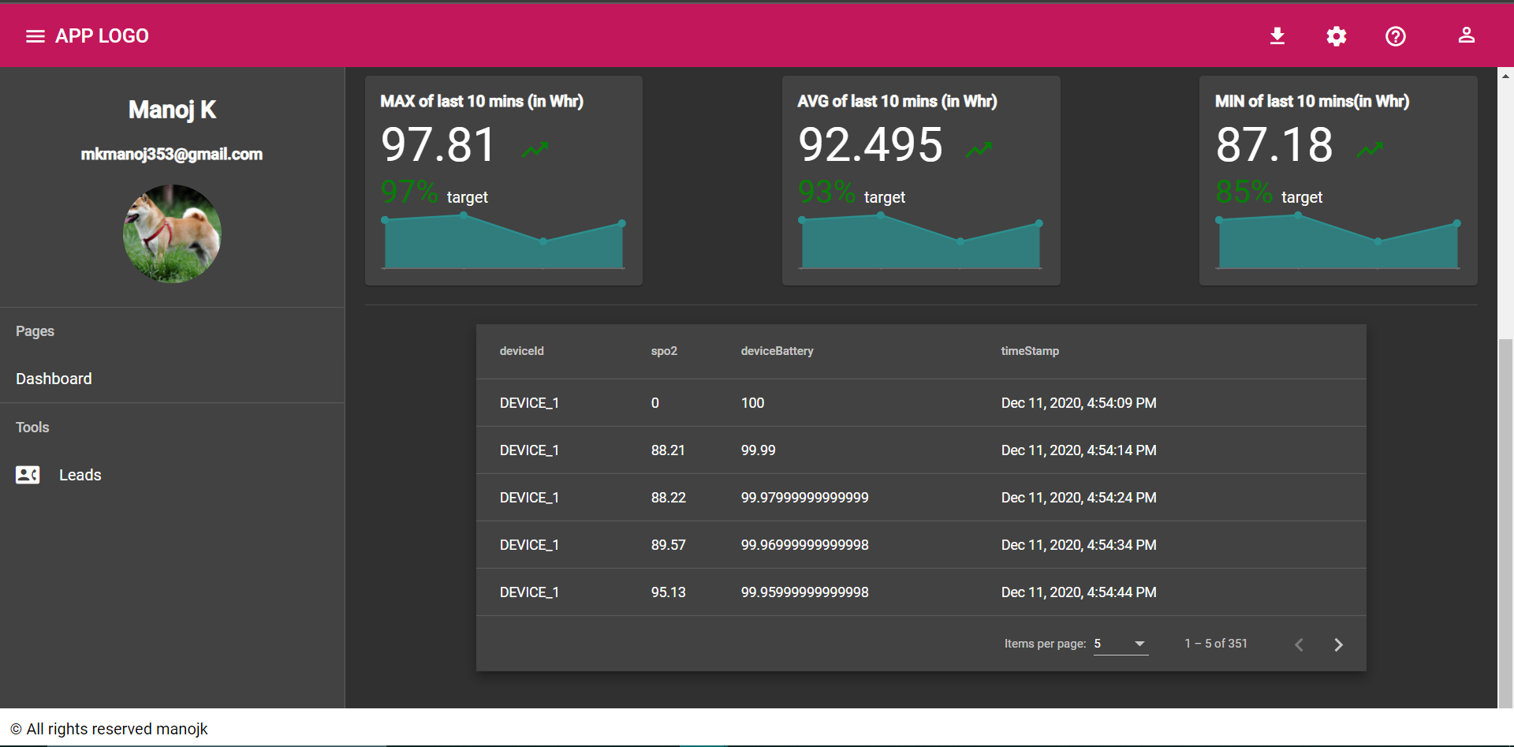
Monitoring Dashboard

Slide 15
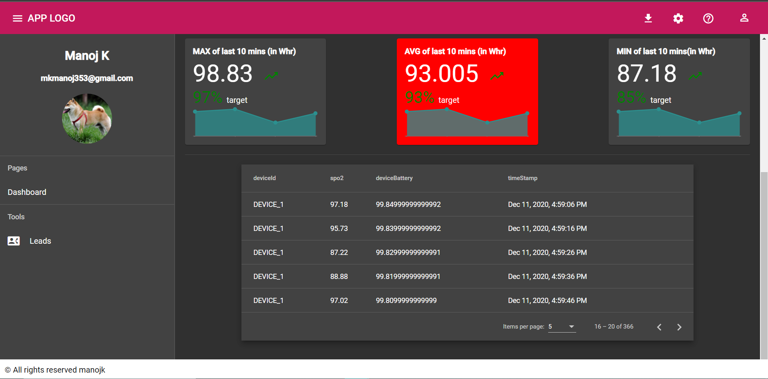
Alert Recognition

Slide 16
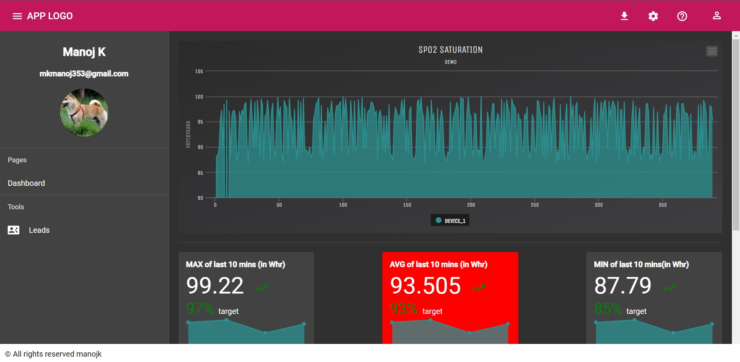
Graph plotting Spo2

Slide 17
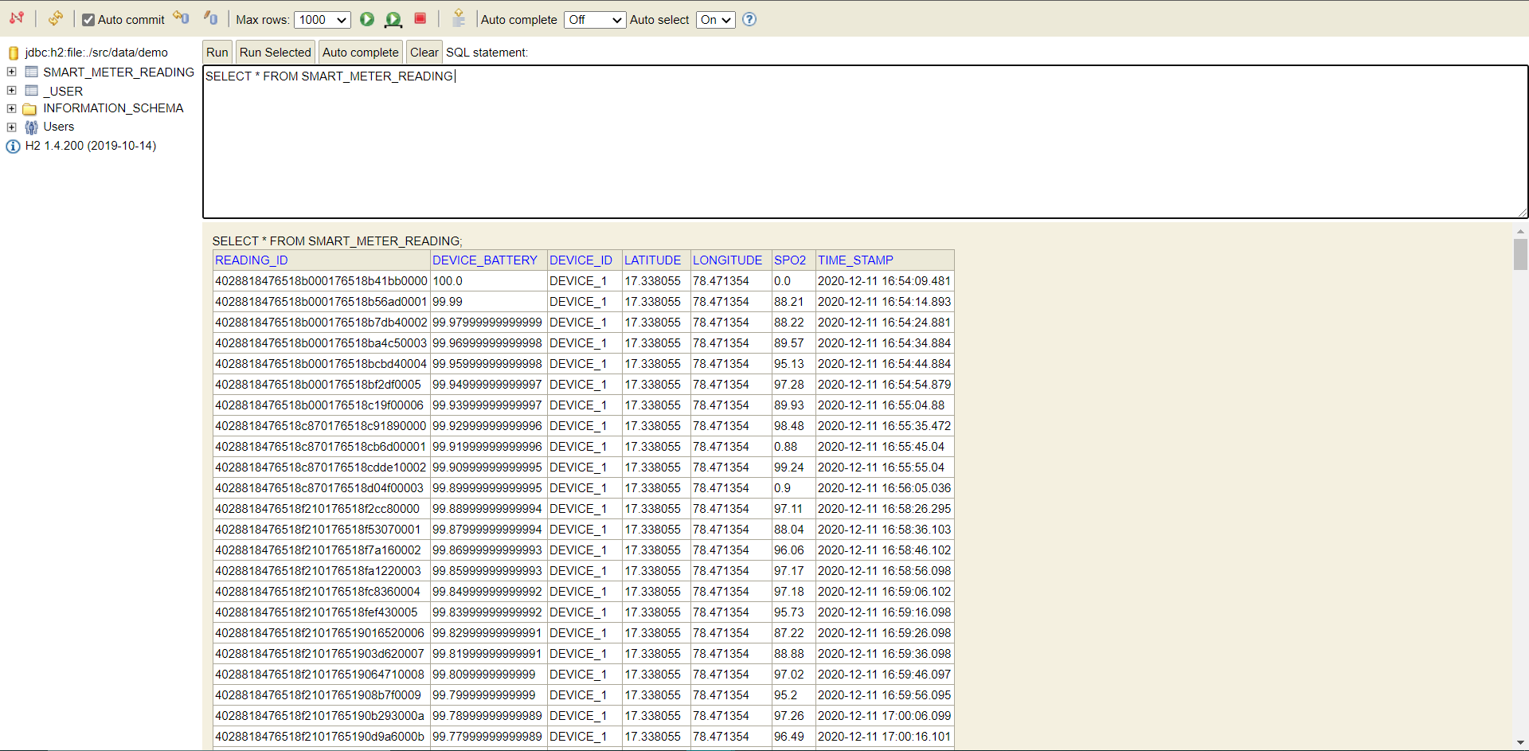
Reading Storage modal

Slide 18
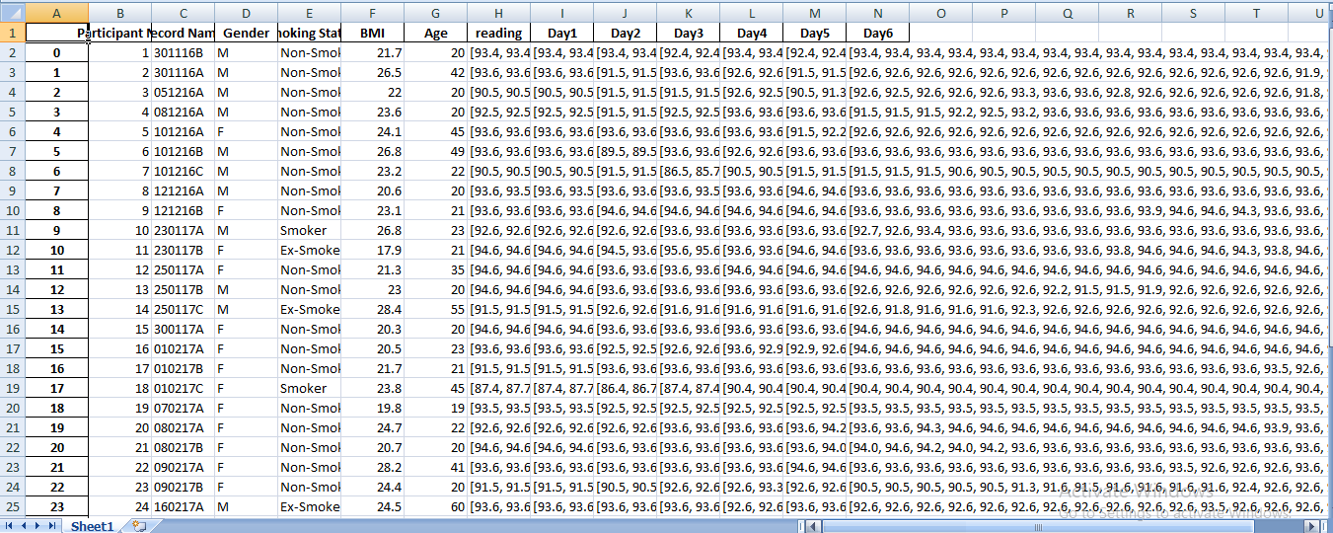
Dataset used for prediction

Slide 19
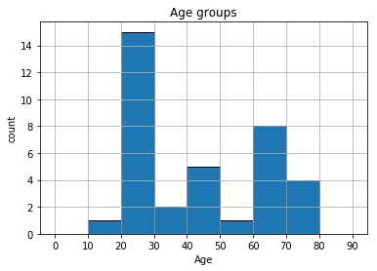
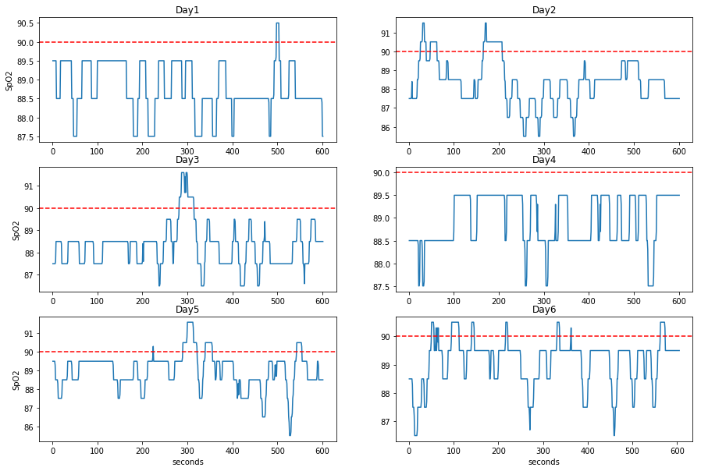
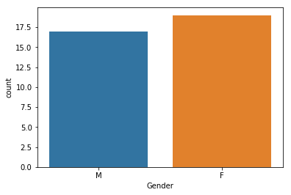
Data Analytics
Figure c
Figure a
Figure b

Slide 20
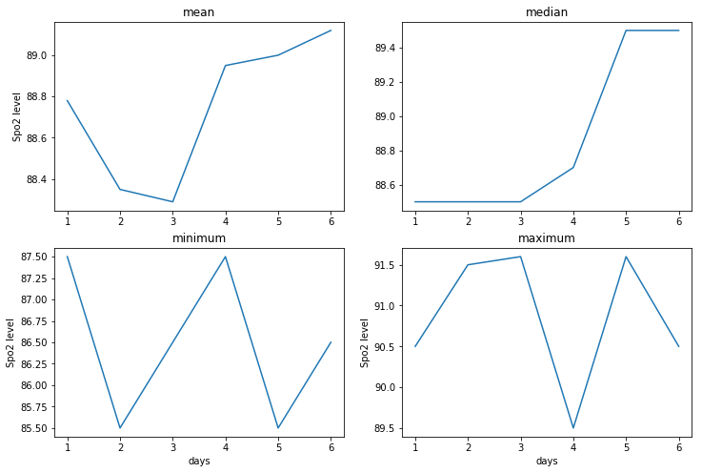
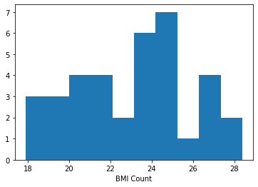
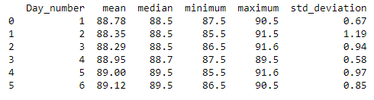
continue..
Figure e
Figure d
Figure f

Slide 21
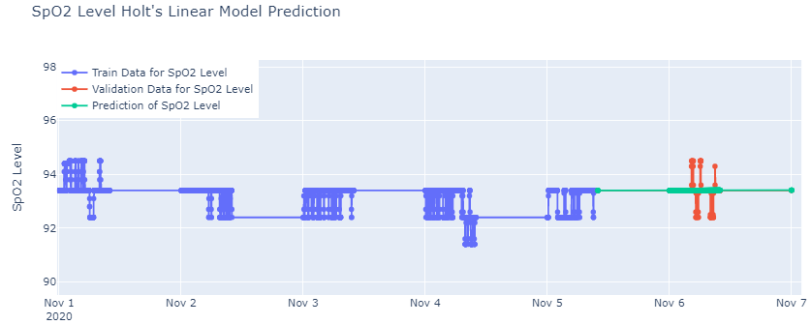
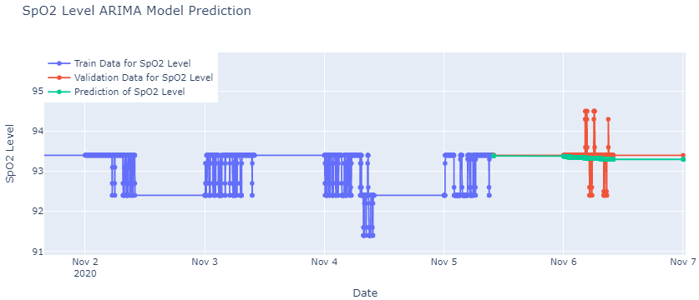
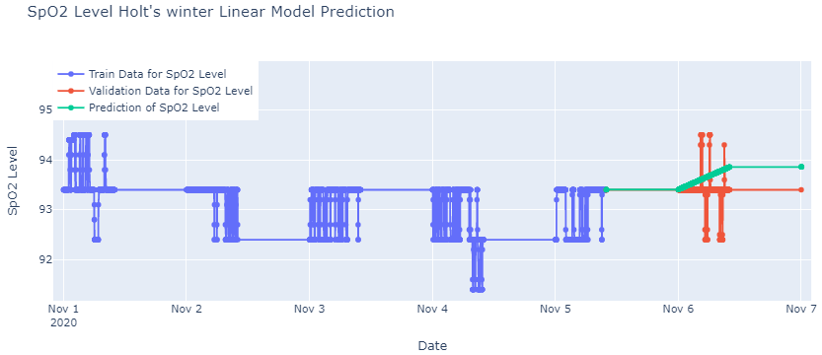
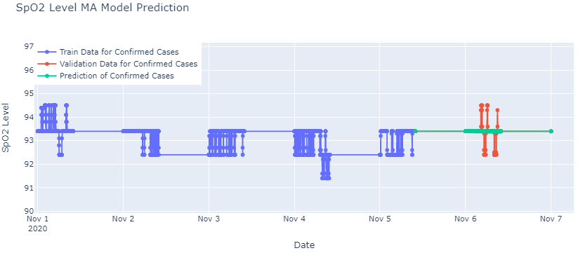
Time-Series forecasting using ML models
Figure g
Figure h
Figure j
Figure i

Slide 22
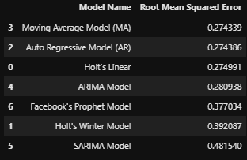
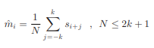
continue..
There are many methods to determine the trend components including least-square (LS) fitting, moving average (MA) filter, Exponential smoothing(Holt’s winter), Holt’s, Auto-Regressive(AR) etc..
The symmetric MA filter used in this study can be expressed as:
where k = 3 for 7-point and 7 for 15-point MA filter, N is the number of readings within 15-day processing window
Figure k

Slide 23
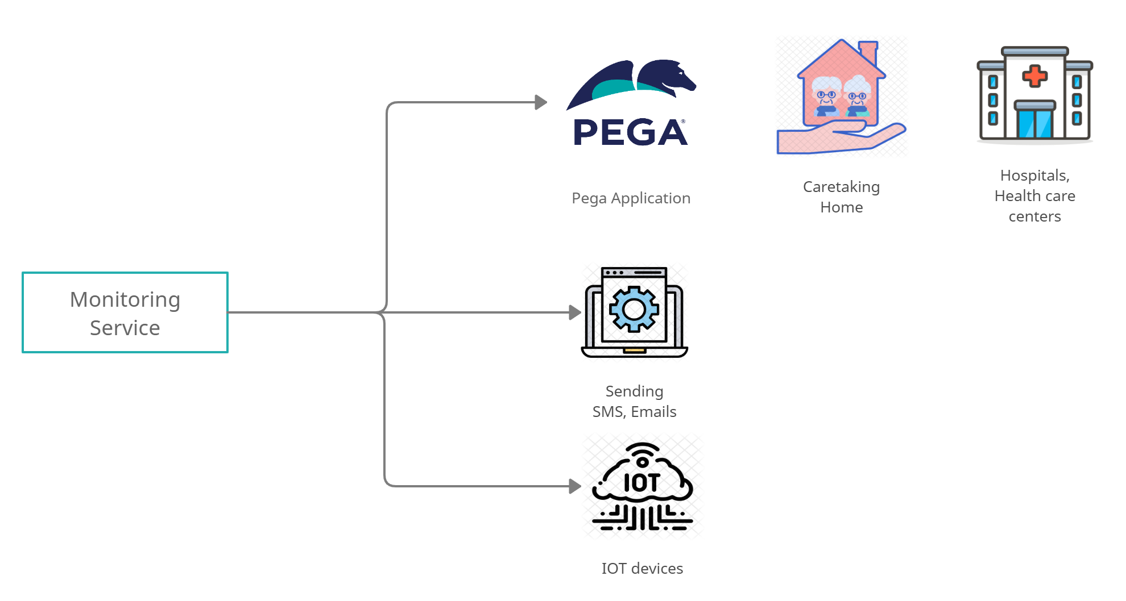
Alerting Infrastructure

Slide 24
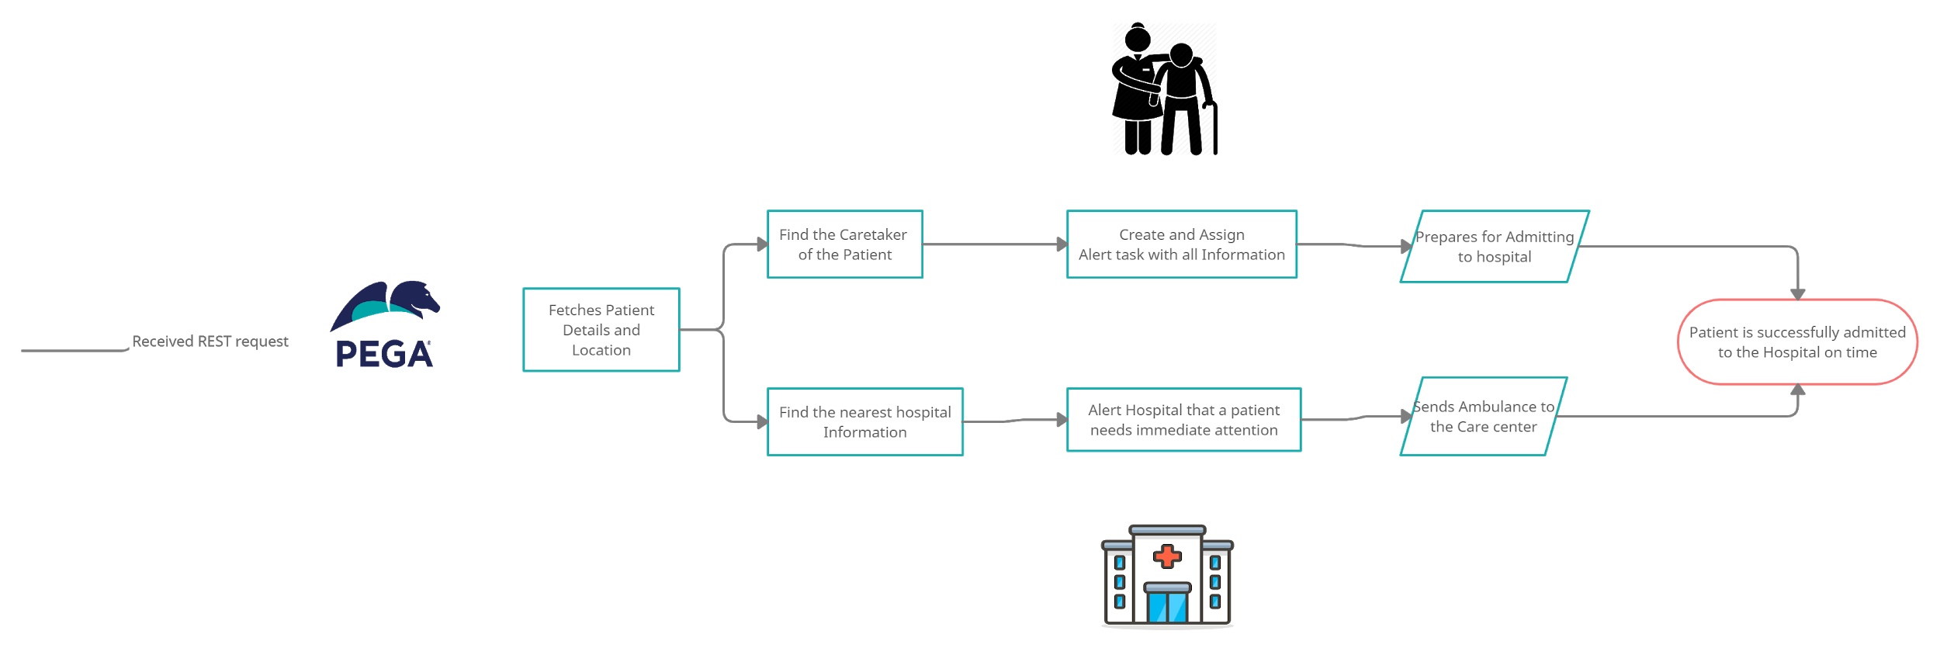
Pega Architecture

Slide 25
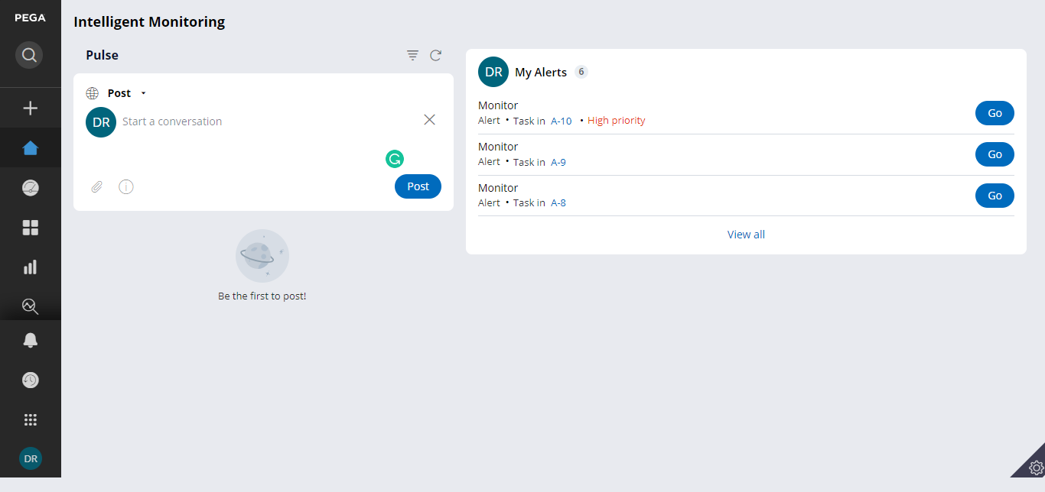
Caretaker Dashboard

Slide 26
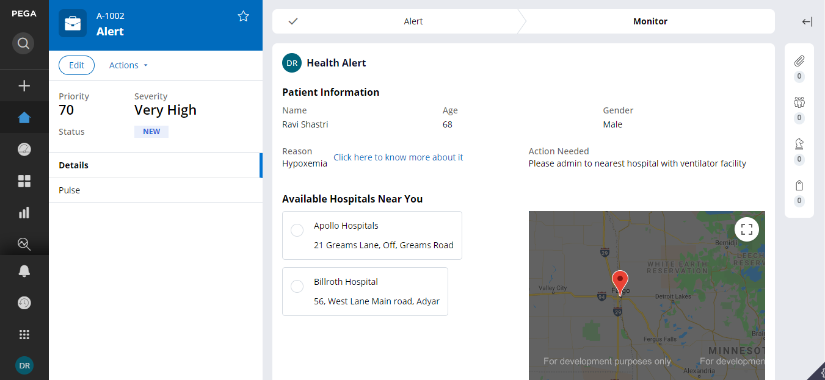
Alert to Caretaker

Slide 27
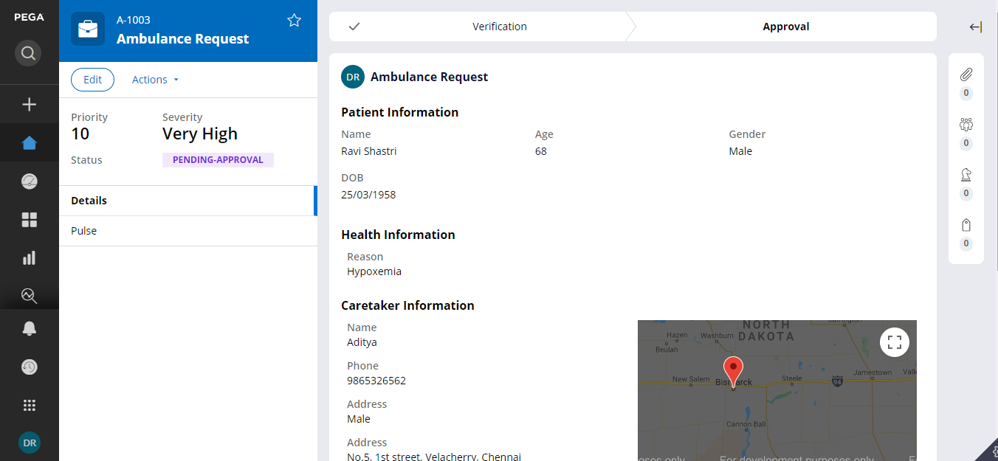
Hospital - Ambulance Request

Slide 28
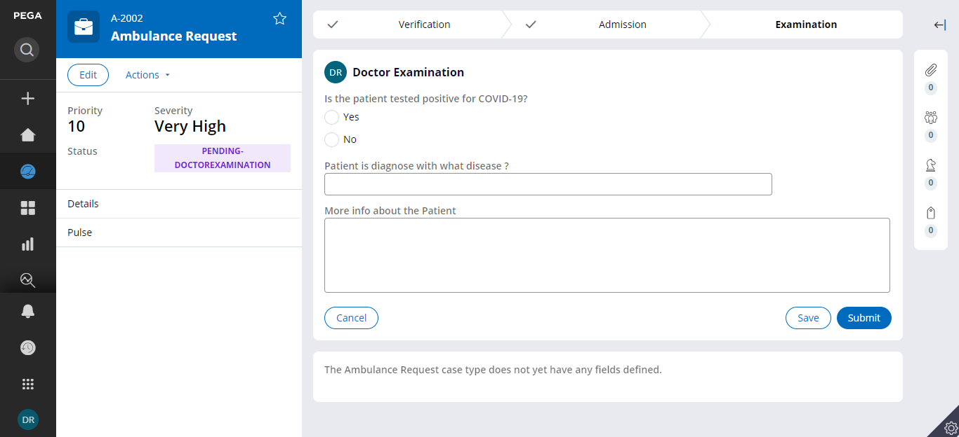
Hospital - Data upload

Slide 29
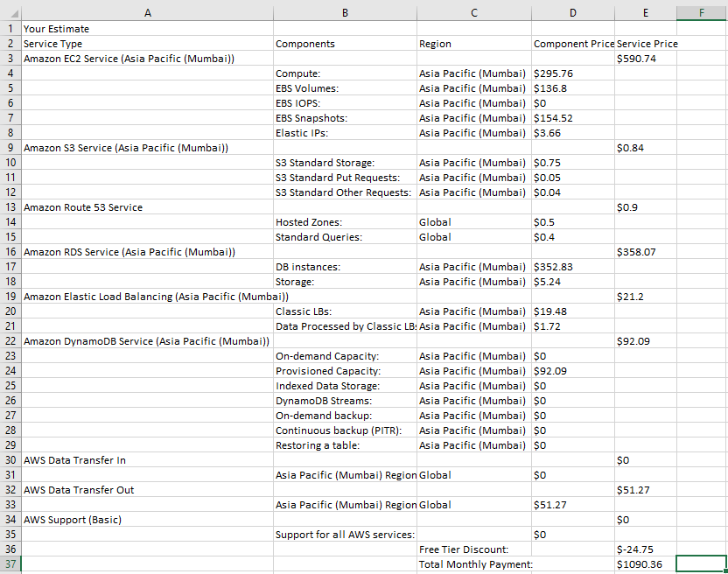
Estimated cost of maintenance

Slide 30
Challenges Faced
Datasize: smaller dataset poses challenge while training a regression model and forecasting based on 6 days of data results in lower forecasting accuracy and hence increases RMS error
Outliers: outliers cannot be learned in Limited data regime and hence had to be dropped from dataset.
Marketing platforms are limited
Movement artifacts, excessive light, nail polish, artificial nails may affect Oximeter levels
Network connectivities in remote areas

Slide 31
Future enhancements
For other disease
1
Solution scalability includes addressing other commonly faced challenges by older adults or disabled in future phases of this project. Example:
phase1: respiratory diseases using Oximeter (currently)
Phase2: health monitoring through smart IOT canes for older adults/disabled(in future)
2
Securing Health records Using Blockchain Technology
In this technology, database is much more secured. If blockchain technology is applied in this field, security level becomes high and hospitals can also use it
3
Apply in healthcare Analytics
Use location tracker in the device and Alert. If the reading of oximeter cross the maximum value, patient could connect with hospital automatically. Alert the patient about the pollution level in a location

Slide 32
Links and references:
https://www.thelancet.com/action/showPdf?pii=S2214-109X%2818%2930409-1
https://ieeexplore.ieee.org/stamp/stamp.jsp?arnumber=7177039
https://www.ncbi.nlm.nih.gov/pmc/articles/PMC5539125/
https://www.123rf.com/clipart-vector/elderly_people.html?sti=nq3e97rq24d8jmnz45|

Slide 33
Thank You

